Slide 1
Compiler Design (22CS302) III B.Tech – I Semester
Department of Computer Science and Engineering

Slide 2
Contents
Institute Vision and Mission
Department Vision and Mission
Compiler Design
Syllabus
Course Outcomes
Introduction to Programming Language
Summary
Department of Computer Science and Engineering

Slide 3
Institute VISION and MISSION
VISION
To evolve into a Centre of Excellence in Science & Technology through creative and innovative practices in teaching – learning, towards promoting academic achievement and research excellence to produce internationally accepted, competitive and world class professionals who are psychologically strong & emotionally balanced, imbued with social consciousness & ethical values.
MISSION
To provide high quality academic programmes, training activities, research facilities and opportunities supported by continuous industry - institute interaction aimed at promoting employability, entrepreneurship, leadership and research aptitude among students and contribute to the economic and technological development of the region, state and nation.
Department of Computer Science and Engineering

Slide 4
Department VISION and MISSION
VISION
To evolve as a centre of high repute in Computer Science & Engineering and create computer software professionals trained on problem solving skills imbued with ethics to serve the ever evolving and emerging requirements of IT Industry and society at large.
MISSION
M1: Imparting quality education through well designed curriculum, innovative teaching and learning methodologies integrated with professional skill development activities to meet the challenges in the career.
M2: Nurture research and consultancy activities amongst students and faculty by providing State-of-art facilities and Industry-Institute Interaction.
M3: Developing capacity to learn new technologies and apply to solve social and industrial problems to become an entrepreneur.
Department of Computer Science and Engineering

Slide 5
Compiler Design
L | T | P | C
3 | 2 | 0 | 4
MODULE-1
UNIT-1 10L+6T+0P=16 Hours INTRODUCTION The evolution of programming languages and basic language processing system; The structure of a compiler; Bootstrapping; Lexical analyser and its Role; Input buffering; Specifications and recognition of tokens; LEX.
UNIT-2 14L+10T+0P=24 Hours SYNTAX ANALYSIS The role of the parser; Context-free grammars; Types of parsers with examples, YACC. Semantic Analysis: Type checking; Syntax directed definition (SDD) and translation schemes (TS); Application of SDD and TS; Translation of expressions and control flow statements.
MODULE-2
UNIT-1 10L+8T+0P=18 Hours
INTERMEDIATE REPRESENTATIONS Three address code; Syntax tree; DAG. Run-Time Environment: Storage organization; Stack allocation - Activation Trees, Activation Records.
UNIT-2 14L+8T+0P=22 Hours
OPTIMIZATION AND CODE GENERATION The principal sources of optimization; Basic blocks and flow graphs; Local optimization; Global optimization and loop optimization. Code Generation: Issues in the design of code generator; Code-generation algorithm – register allocation and assignment and peephole optimization.
Department of Computer Science and Engineering

Slide 6
Compiler Design
L | T | P | C
3 | 2 | 0 | 4
COURSE OUTCOMES:
Upon successful completion of this course, students will have the ability to:
CO No. | Course Outcomes | Blooms Level | Module No. | Mapping with POs
1 | Apply the different phases of compiler with various examples. | Apply | 1 | 1, 12
2 | Design different parsing and optimization techniques in the design of compile. | Design | 1 | 1, 2, 12
3 | Analyze the code optimization techniques. | Analyze | 2 | 1, 2, 3, 12
4 | Analyze the algorithm for compiler segments and evaluate the algorithm for optimized code generation. | Analyze | 2 | 1, 2, 3, 12
TEXTBOOKS:
Alfred V. Aho, Monica S. Lam, Ravi Sethi and Jeffrey D. Ulman, “Compilers: Principles, Techniques and Tools”, 3rd Edition, Pearson Education, 2019.
Thomson, “Introduction to Theory of Computation”, 2nd Edition, Sipser, 2016.
Department of Computer Science and Engineering

Slide 7
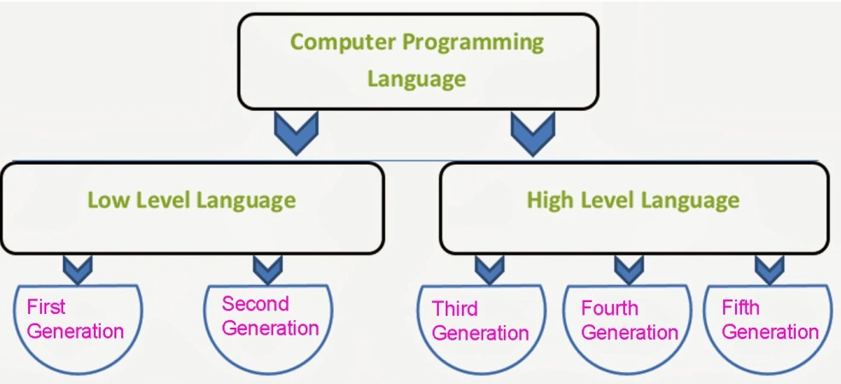
GENERATIONS OF PROGRAMMING LANGUAGE
Department of Computer Science and Engineering

Slide 8
FIRST GENERATION LANGUAGE (1-GL)
Binary or Machine language or Low level language
These binary languages are mostly based on 0&1.
Executed very fast.
Difficult to understand.
Complicated task and time consuming.
More chances of error and debugging is more difficult and machine dependent.
Department of Computer Science and Engineering

Slide 9
SECOND GENERATION LANGUAGE (2-GL)
also called as Assembly Level Language
MNEMONICS are directly used in the user program
Example:
A=B+C Load B into r0
Load C into r1
r1 r0 + r1
store r1 into A
Requires translator
Department of Computer Science and Engineering

Slide 10
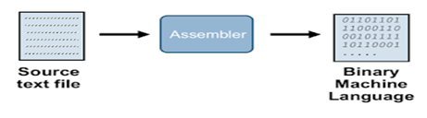
Assembler
Assembler is the language translator that converts assembly language code into the binary equivalent usually known as object code (machine code).
Department of Computer Science and Engineering

Slide 11
Assembler
Pros:
Less chances of errors
Debugging is easier and More flexible
Cons:
Program will not run on another processor
Know the details of hardware and addressing modes
The source code is long and unreadable
Department of Computer Science and Engineering

Slide 12
THIRD GENERATION LANGUAGE (3-GL)
It is also known as High level language
More machine-independent and more programmer- friendly.
The programs are easier to read, write, and maintain.
English words are used to denote variables, programming structures and commands, and Structured Programming
Examples: FORTRAN, C, C++, JAVA
Code1: printf (“ welcome” );
Department of Computer Science and Engineering

Slide 13
FOURTH GENERATION LANGUAGE (4-GL)
The fourth-generation languages, or 4GL, are languages that consist of statements similar to statements in a human language. Fourth generation languages are commonly used in database programming and scripts examples include Perl, PHP, Python, Ruby, and SQL.
Department of Computer Science and Engineering

Slide 14
FIFTH GENERATION LANGUAGE (5-GL)
The fifth-generation languages, or 5GL, are programming languages that contain visual tools to help develop a program. Examples of fifth generation languages include Mercury, OPS5, and Prolog.
Department of Computer Science and Engineering

Slide 15
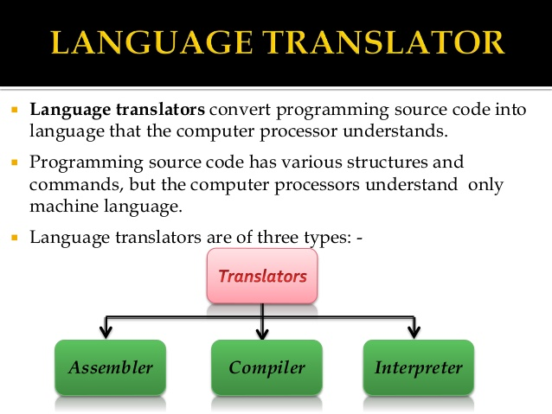
Translators
A translator inputs and then converts a source program into an object or target program.
Source program is written in a source language.
Object program belongs to an object language.
A translators could be: Assembler, Compiler, Interpreter
Department of Computer Science and Engineering

Slide 16
Interpreters
An interpreter is another common kind of language processor. Instead of producing a target program as a translation, an interpreter appears to directly execute the operations specified in the source program on inputs supplied by the user.
The basic model of interpreter can be represented as follows.
Source
Program
Interpreter
Output
Input
Error messages
Department of Computer Science and Engineering

Slide 17
Compilers
Compiler is a program which takes one language (the source language) as input and translates it into an equivalent another language (the object or target language).
During this process of translation if some errors are encountered then compiler displays them as error messages. The basic model of compiler can be represented as follows.
Source
Program
Compiler
Target
Program
Error messages
Department of Computer Science and Engineering

Slide 18
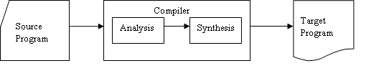
The Analysis-Synthesis Model of Compilation
There are two parts to compilation:
In analysis phase, an intermediate representation is created from the given source program.
Lexical Analyzer, Syntax Analyzer and Semantic Analyzer are the parts of this phase.
In synthesis phase, the equivalent target program is created from this intermediate representation.
Intermediate Code Generator, Code Generator, and Code Optimizer are the parts of this phase.
Department of Computer Science and Engineering

Slide 19
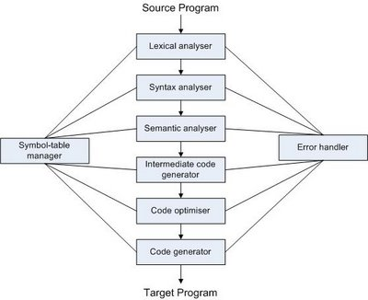
Phases of Compiler
Department of Computer Science and Engineering

Slide 20
THANK YOU
Department of Computer Science and Engineering

